Slide 1

Textual Style Transfer with GPT-2
Project Site - https://osiajod.github.io/cs205_project/
Group 8 - Michael Downs, Cameron Hickert, Wen Rui Liau, Wisoo Song

Slide 2
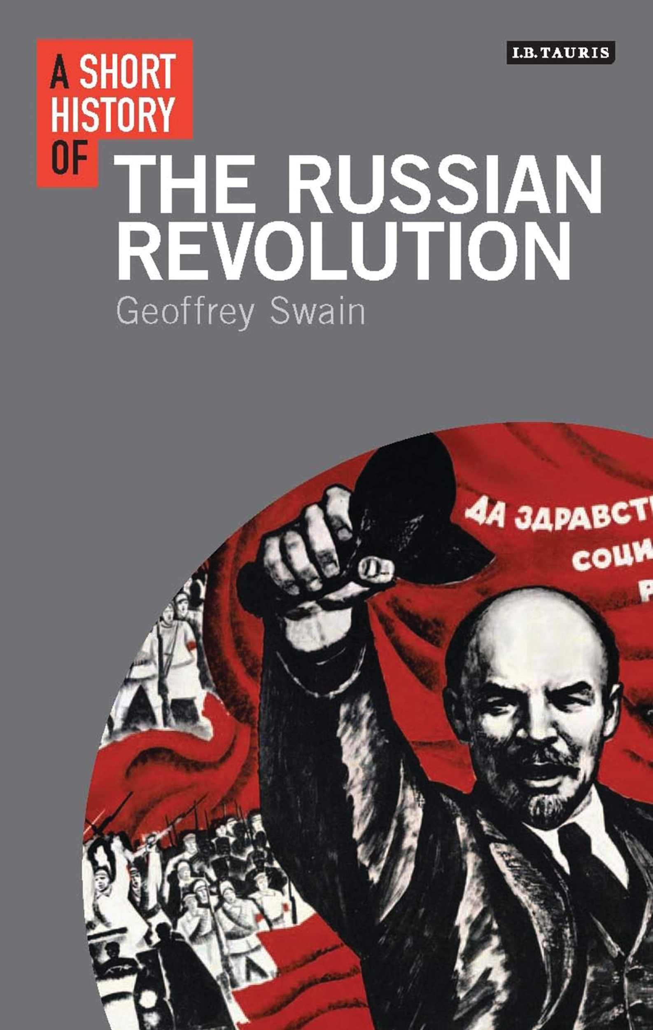
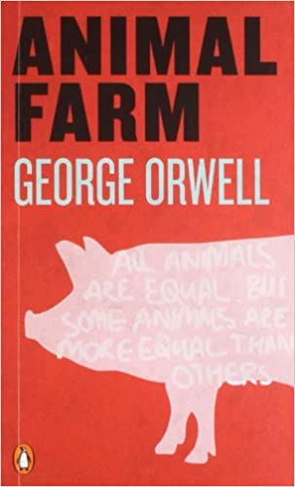
Textual Style Transfer
Two facets of any written work are content and style.
Content pertains to the events or ideas being described
Style pertains to the manner in which the events or ideas are being described
For example, a fantasy novel will differ from an encyclopedia article in terms of both content and style while two news articles describing the same events may differ only in style.
Different authors and/or mediums have different styles. Textual style transfer aims to modify the style of one work to mimic the style of another while keeping the content relevant to the original.
GPT-2 for textual style transfer: Fine-tune GPT-2 on source style text, and conditionally generate text using prompts from target

Slide 3
Generating Text
Example: Window size of 3, step size of 2, 2 sentences generated
Round 1
Sentence 1
Sentence 2
Sentence 3
Sentence 4
Sentence 5
Generated Sentence 1
Generated Sentence 2
Above context used to generate sentences 1 and 2....
Round 2
Sentence 1
Sentence 2
Sentence 3
Sentence 4
Sentence 5
Generated Sentence 1
Generated Sentence 2
Generated Sentence 3
Generated Sentence 4
Above context used to generate sentences 3 and 4…

Slide 4
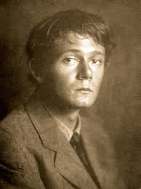
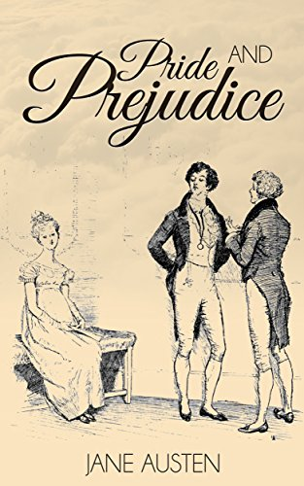



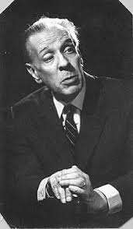

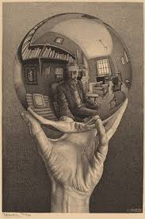
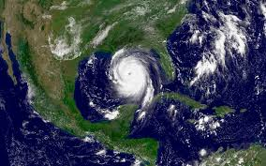
TEXTual Style Transfer
C. A. Smith
Sci-Fi
19th Century
M. C. Escher Wikipedia article
Jorge Luis Borges short story
Gulf of Mexico hurricanes news article
Juvenile Literature
Source styles:
Zothique
Sci-FI
19th Century
Juvenile
Target texts:
“The Circular Ruins” by Jorge Luis Borges
A wikipedia article on M. C. Escher (https://en.wikipedia.org/wiki/M._C._Escher)
A news article on hurricanes in the gulf of mexico (https://www.washingtonpost.com/weather/2020/03/31/gulf-of-mexico-warm-tornadoes-hurricanes/)

Slide 5
Generated text examples - Hurricane NewsTarget Text
Sci-Fi Source Text: Of course, there is always the matter of the precipitation, to be followed by a storm. Of course there is always the difference of some elements in the quality of the rainfall, the change of trees, the increase of farm facilities became manifest when it breaks over, and a generation of adults has been almost universally-attuned to such-day. The fundamental Earth provides a constant reminder, though, of the fact that the sun’s waters came from the sea in summer and seas came into winter, not from the rain of the present; that the weather has stayed here, not from the present. But there, on the other hand, there is something about the juice that goes by from the down which the water moved last year and now passes it.
Zothique Source Text: Borne like a leaf on the moonless shore of the storm, bands of bright-plumaged serpents poured in a steadily upwards glimmer. Higher they climbed, following a dimly shifting wall of glass. One by one, the mysterious forms began to trouble the pacemonium’s nervous system. A red, swollen moon rose red as with saniesmingled blood, under the saffron lamps; and before her too was the dry, sybil-clotted air.

Slide 6
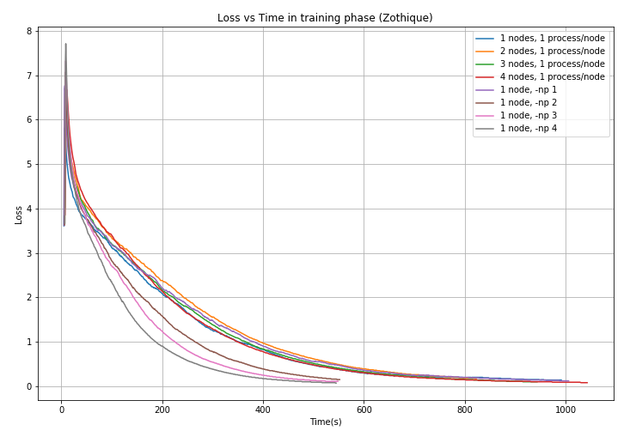
Training Plots (small dataset)
Parallel model on AWS EC2 g4dn.12xlarge instance
4 Nvidia T4 Tensor Core GPUs
Plot of Training Loss vs Time Taken
Single Node vs Multinode parallelism
Single Node is faster!
117 million parameters to train
Significant communication overhead

Slide 7
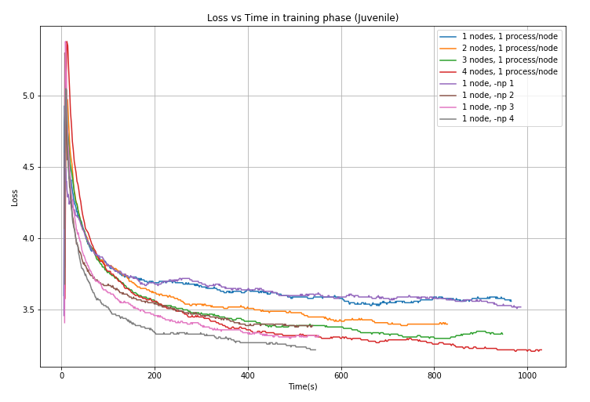
Training Plots (big dataset)
Similar results for training on the big dataset
Single Node vs Multinode parallelism
Single Node is faster!
117 million parameters to train
Significant communication overhead

Slide 8
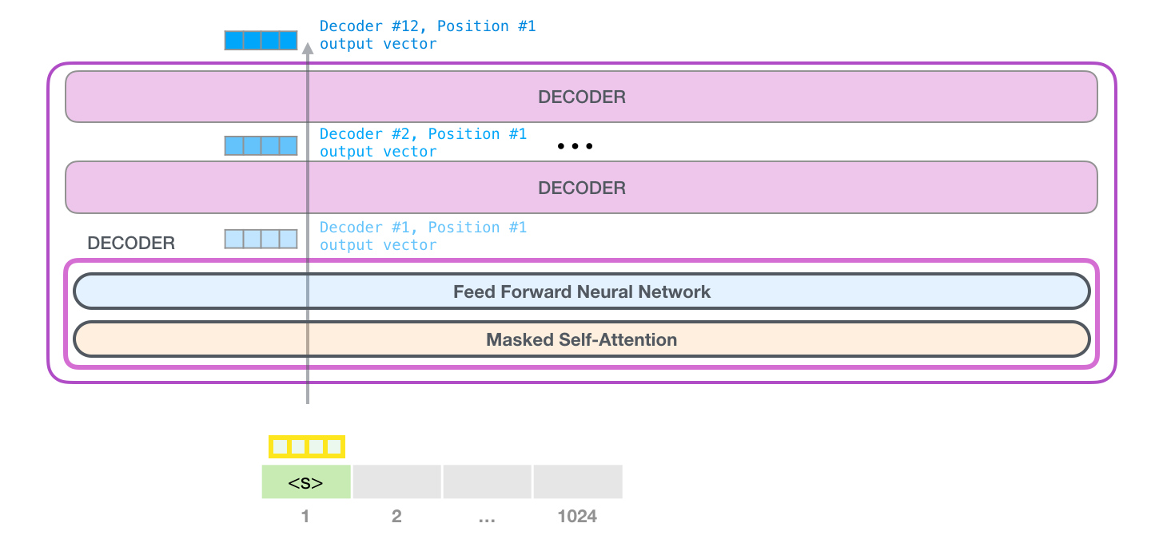
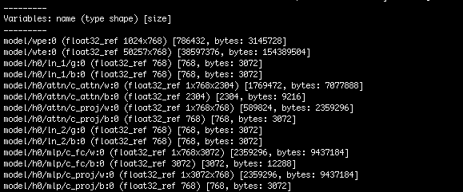
Data Parallelism & Model Parallelism
Data parallelism : use the same model for every thread, but feed it with different parts of the data
Model parallelism: use the same data for every thread, but split the model among threads

Slide 9
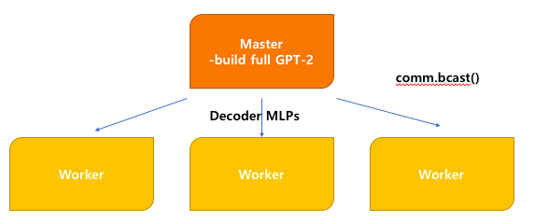
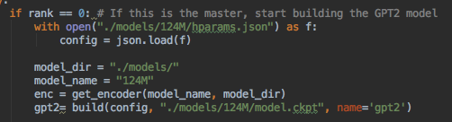
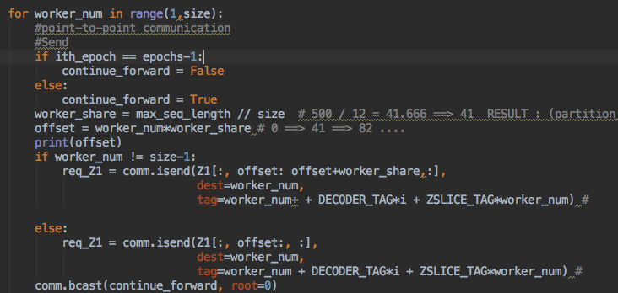
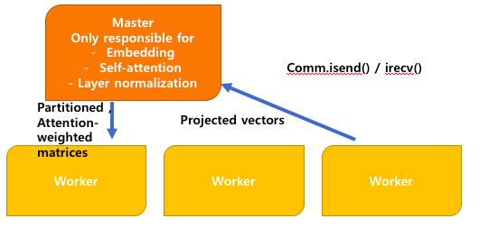
Data Parallelism & Model Parallelism
src/parallel_test.py

Slide 10
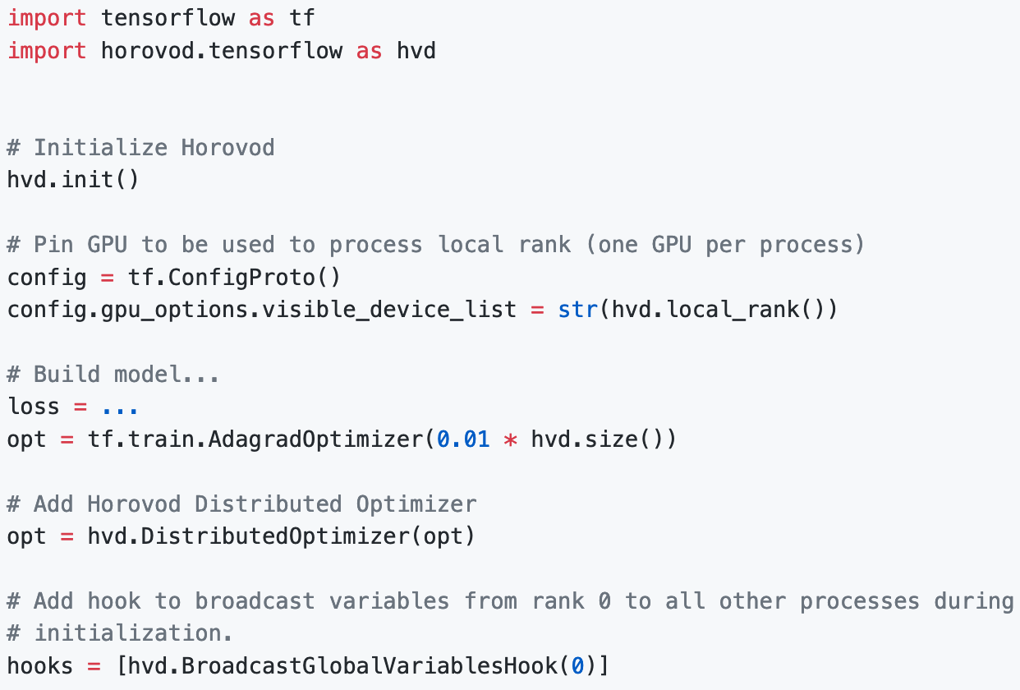

Insight: Horovod works well except when it doesn’t
Works well once you know what to do
API is more or less straightforward -- see right example of wrapping a pre-existing tensorflow script
Debugging painful, error messages are cryptic, usually just segmentation faults and massive stack traces coming from underlying nvidia libraries such as nccl
At one point we passed the wrong interface as an argument to the horovd mpi wrapper script and the resulting error message was not at all related
Scant resources for debugging your specific issue
Latest version is 0.19 -- says it all.
Notes:
One of our main pain points for the project was getting Horovod working and understanding the cryptic error messages it throws when something goes wrong. We want to emphasize that when it works, it works well, but the road to getting it working is not straightforward for novices.
It does several things well, however. For example, one of the design goals of Horovod was to make it easy to wrap over an existing script. Our experience is that this design goal was largely achieved. As can be seen in the top right, all that one has to do to integrate horovod into a script is to add some boilerplate code.
Even though modifying an existing codebase to use Horovod is straightforward, getting the underlying infrastructure to run it configured properly can be tedious and difficult, mainly because of weird incompatibility between it, tensorflow, and the gcc toolchain as well as its less than helpful error messages. For example, at one point, we passed in the wrong interface as an argument to the horovodrun wrapper script and the error message it threw at us seemed not at all related to the actual problem. We couldn’t find any resources online addressing our specific issue, and were lucky that we even found a semi-related solution buried halfway through a github issue. We acknowledge that some of the error messages are coming from lower down in the stack for example from nVidia’s nccl library, but the troubleshooting guide for these issues is incomplete in the Horovod documentation.
Finally, the latest version if 0.19, which says it all.

Slide 11
Insight: Textual style transfer is still a very nascent area of study
Literature only goes back to 2016/2017
We had originally wanted to to use three metrics proposed by Remi et al. (https://arxiv.org/pdf/1904.02295.pdf) but this would have entailed a fair amount of extra work including training and debugging several auxiliary models
Did not find any simple metrics for assessing quality of style transfer between two texts in a largely unsupervised manner -- this is an active area of research
As per the theme of the course, we wanted to focus more on the computational aspect of the project rather than the NLP component
Notes:
Another insight we gained was that the area of textual style transfer is still very nascent. We had expressed interest in using a recent MIT Media Lab paper proposing three metrics for assessing the quality of textual style transfer, but after looking into it more carefully, we found out using the methods proposed in that paper would require more work than we could justify given the timeframe and focus of the project. These metrics involved training several different auxiliary deep learning models, gathering and formatting more data, and also were aimed more at assessing sentence-level style transfer rather than document level style transfer.
As the focus of the class is on computation and not NLP, we decided to sideline this analysis for another time. We did not find any easy way to, in a largely unsupervised manner, assess the quality of style transfer between two different texts and acknowledge that this is still an active area of research.

Slide 12


Insights: on versions and platforms
Value of pursuing multiple platforms improve project flexibility in cases of unforeseen issues
Cannon implementation still interests us
Difficulty getting Horovod to run on Cannon
Segmentation faults
Old codebases
TF1 v. TF2
Older versions of GCC and OpenMPI
Ultimately used AWS instances with Deep Learning AMI. Once we ironed everything out (which took a while) the implementation was relatively straightforward.

Slide 13

Insights: language models are unsupervised multitask learners
The central claim of the paper introducing the GPT2 models
Our style transfer algorithm is relatively naive, but still the results manage to capture interesting features
The narrative ‘voice’ is notably present
Preserves a variety of important features in writing
Remember: small (117M-parameter) model
Future:
Poetry
Code
CS205 reading responses?

Slide 14
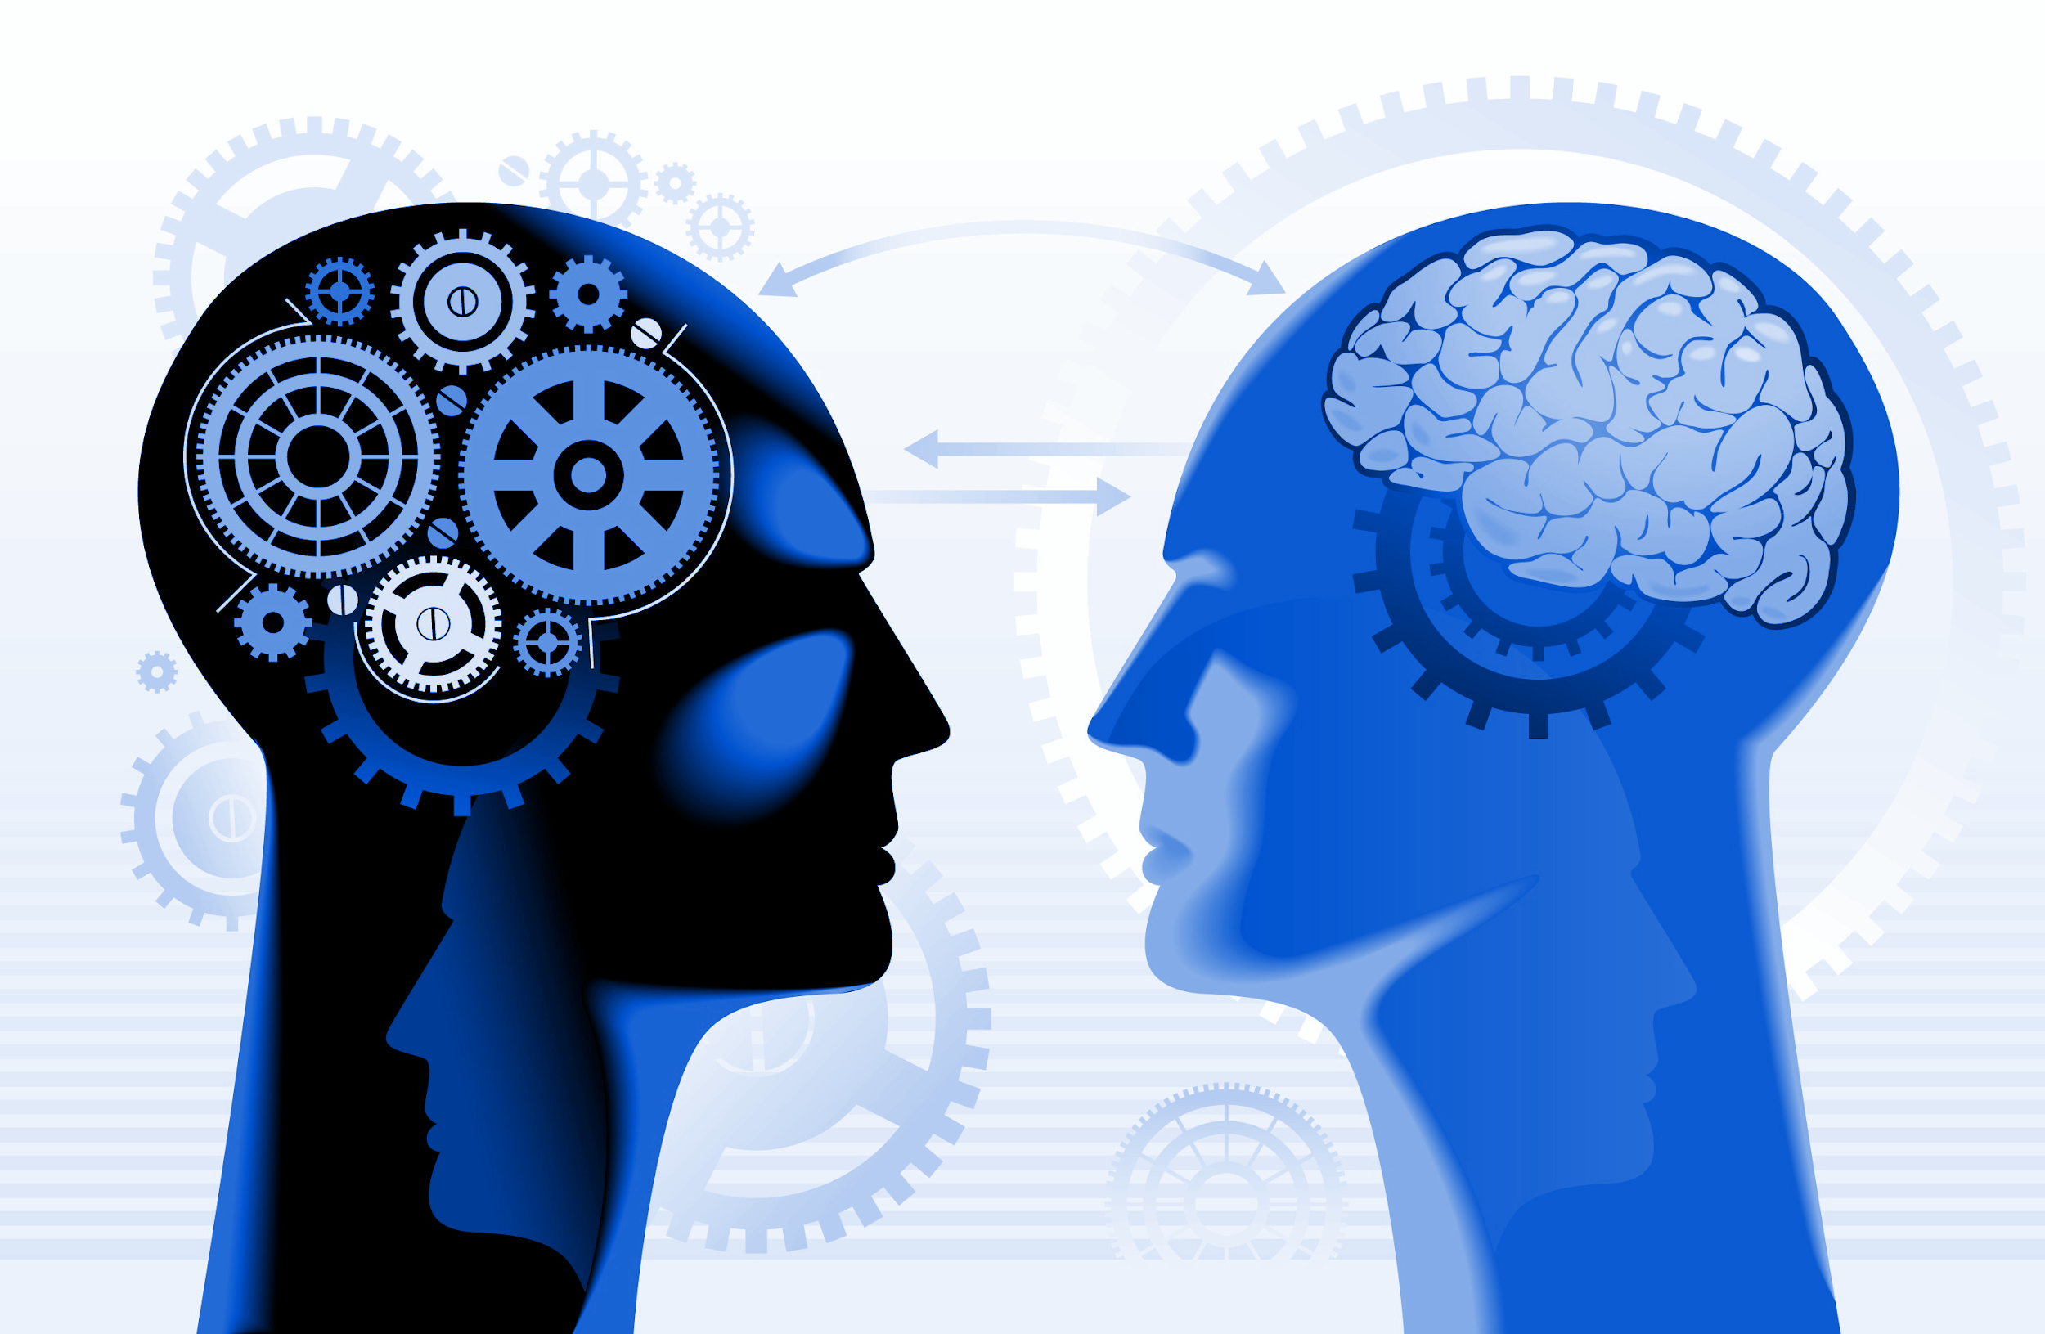
Conclusion
Big takeaway: style transfer is cool
And makes for an effective use case for many of the parallelism methods we have learned in this class.
We just scraped the surface here, and were still able to see the notable benefits of parallelism.
…. also: when in doubt, boost RAM
Questions?

